Slide 1

PRODUCT PRESENTATION
RECOMMENDATION ENGINES FOR MARKETING APPLICATION

Slide 2

PROBLEM STATEMENT
We are provided with two different datasets.
IMDB Top 1000
Movie Lens
Develop an algorithm to give recommendations based on past data.

Slide 3

WAY FORWARD
Objective
Methodology & Algorithms Used
Data Merge, Cleaning & Pre – Processing
Collaborative Filtering
Content Filtering
Two Tower Model
Demo
Summary
Future Work

Slide 4
OBJECTIVE
Understanding the two datasets.
Merge datasets together to create a final data.
Formulation and decision of the algorithms to be used.
Make a UI for recommendations.

Slide 5

ABOUT DATASET – MOVIE LENS
MovieLens was founded in 1997 by GroupLens Research, a research lab in the Department of Computer Science and Engineering at the University of Minnesota, to collect research data on personalised suggestions.
The full data set contains 26,000,000 ratings and 750,000 tag applications applied to 45,000 movies by 270,000 users. It also includes tag genome data with 12 million relevance scores across 1,100 tags (Last updated 8/2017).

Slide 6

ABOUT DATASET - IMDB
IMDb (also known as the Internet Movie Database) is an online database of information related to movies, it combines movie plot description, Metastore ratings, critic and user ratings and reviews, release dates, and many more aspects.
This dataset includes IMDB top 1,000 movies of all time with attributes such as Title, Certificate, Duration, Genre, etc.

Slide 7
DATASET
Movie
Movie ID
Title
Genre
Rows – 27,278
Rating
User ID
Movie ID
Rating
Time Stamp
Rows – 20,000,263
IMDB
Series Title
Overview
Rows - 1000

Slide 8
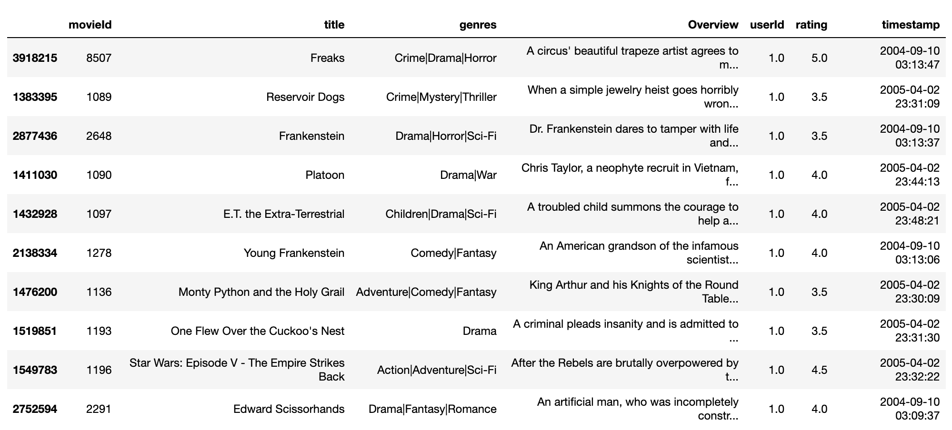
FINAL DATASET

Slide 9
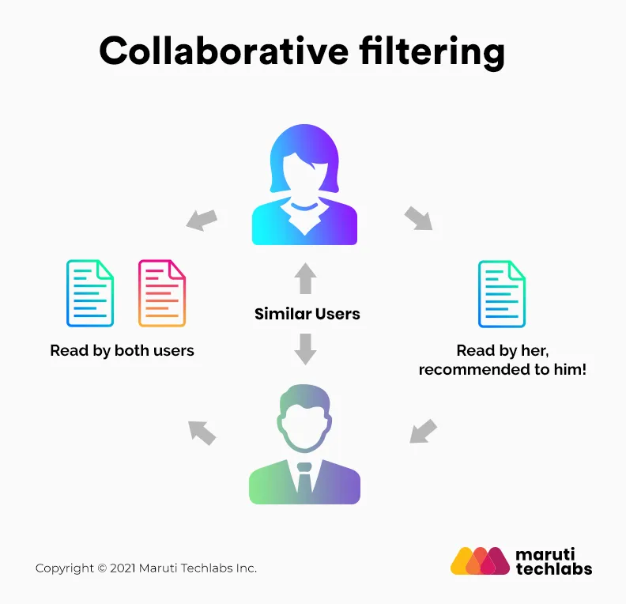
COLLABORATIVE FILTERING
Collaborative Filtering recommends items based on similarity measures between users and/or items.
The basic assumption behind the algorithm is that users with similar interests have common preferences.

Slide 10
COLLABORATIVE FILTERING – MEMORY BASED
Import Dataset
Fill the Nan values with 0
Create cosine similarity matrix on user and item separately
Recommend on user and item separately.

Slide 11
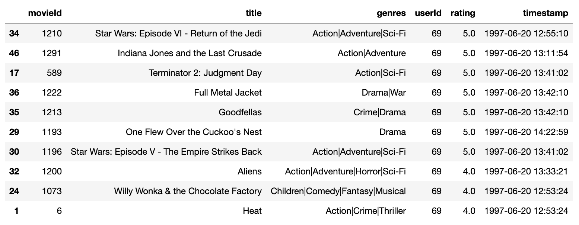
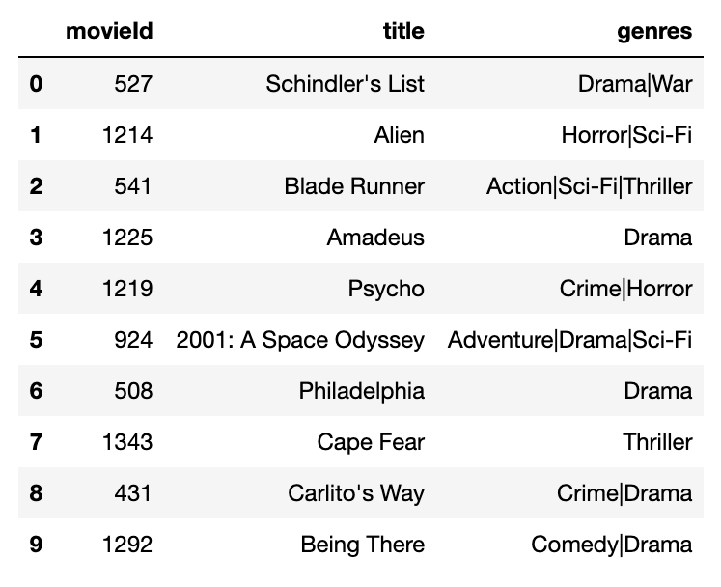
COLLABORATIVE FILTERING – MEMORY BASED ON USER RECOMMENDATIONS
Movies liked by user id 69
Movies recommended to user

Slide 12
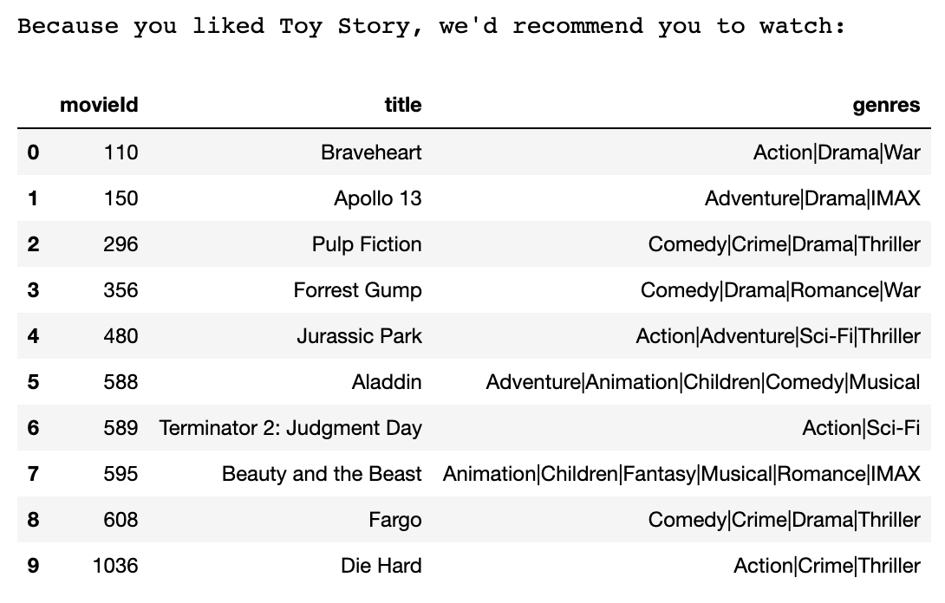
COLLABORATIVE FILTERING – MEMORY BASED ON ITEM RECOMMENDATIONS

Slide 13
COLLABORATIVE FILTERING - KNN
Import data
Create a User – Item Matrix
Create a Sparse Matrix
Create mapper from movie title to index
Fit and train the model
Generate Recommendations

Slide 14
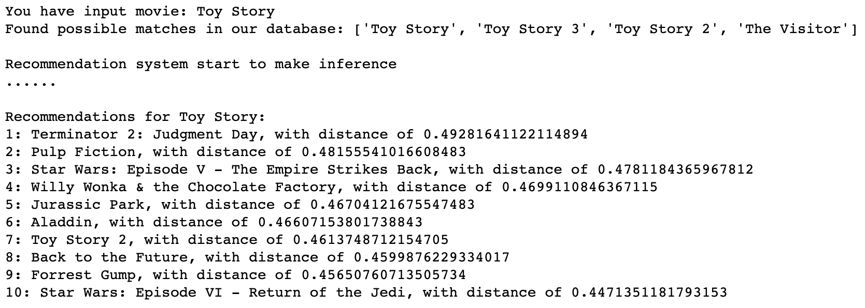
COLLABORATIVE FILTERING – KNN RECOMMENDATION

Slide 15

COLLABORATIVE FILTERING - SVD
Import Data
Data Preparation
Mean Normalization
Singular Value Decomposition(SVD)
Matrix Multiplication and Mean Addition
Recommendation Generation
Notes:
Data Preparation: The ratings are arranged in a user-item matrix with users as rows, items (movies) as columns, and ratings as cell values.
Mean Normalization: The mean user rating is subtracted from each user's ratings to normalize the data. This helps to handle users who haven't rated many items and also to reduce bias.
Singular Value Decomposition (SVD): A matrix factorization technique used to reduce a matrix into its constituent parts. It's a way of extracting latent factors/features that underline the interactions between users and movies.
Matrix Multiplication and Mean Addition: The decomposed matrices are multiplied together and the user mean ratings are added back to generate a prediction matrix. This matrix holds the predicted ratings for all movies and users.
Recommendation Generation: The system makes recommendations by picking movies with the highest predicted ratings that the user hasn't already rated. The recommended movies are sorted in descending order of predicted ratings. The goal is to recommend the top-N movies that the user would like the most, based on the user's rating history.

Slide 16
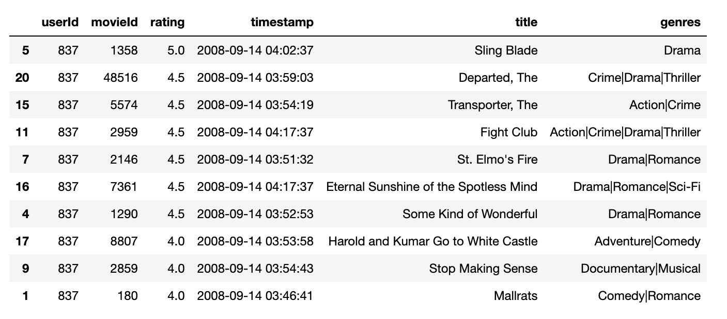
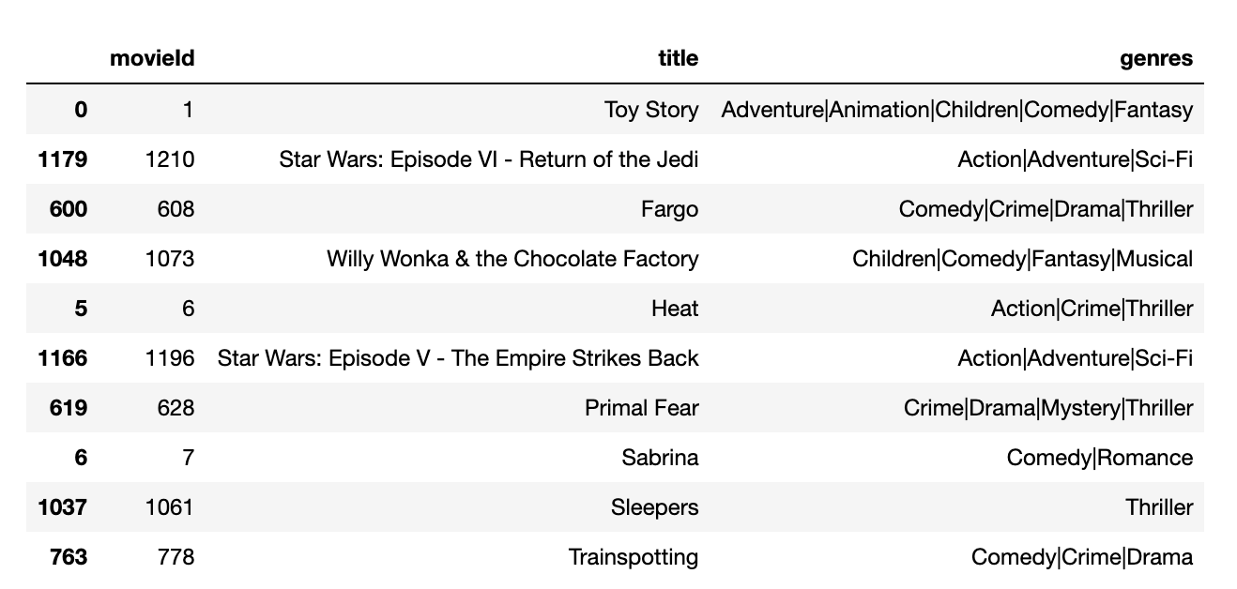
COLLABORATIVE FITERING – SVD RECOMMENDATIONS
Movies already rated by user 837
Movies recommended to user 837

Slide 17

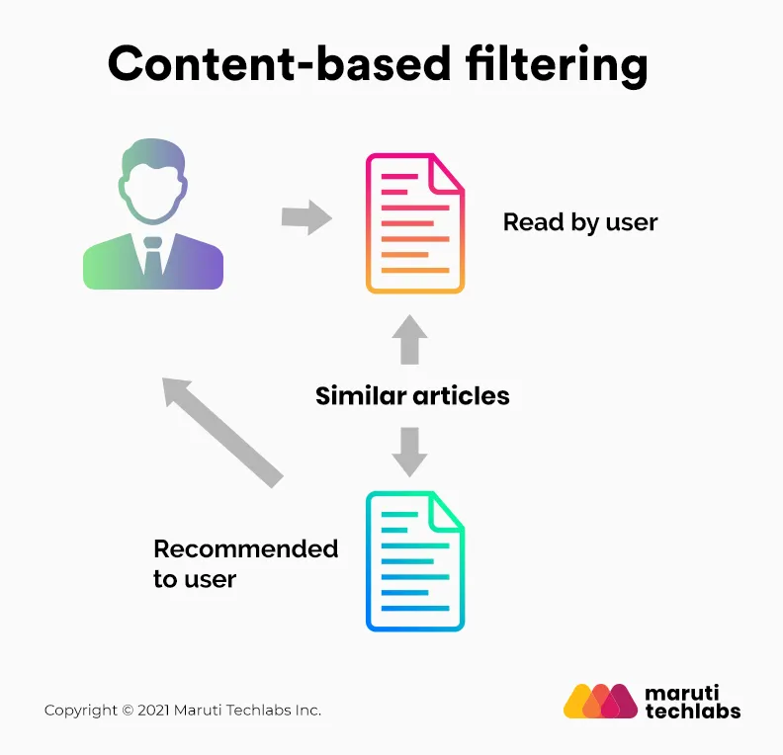
CONTENT BASED
Content-based filtering uses item features to recommend other items similar to what the user likes, based on their previous actions or explicit feedback.

Slide 18
CONTENT BASED – TF IDF
Import Data
Data Processing
TF – IDF Feature Extraction
Similarity Measurement
Recommendation Generation
Notes:
Data Preparation: First, you import necessary libraries, load your dataset from a .csv file, and perform a basic examination of the data, including looking at the first few records, checking the shape of the dataframe, finding the number of null values, and checking the data types of the columns.
Data Cleaning: You copy the dataframe, select the 'movieId', 'title', 'genres' columns for processing, and drop duplicate records.
TF-IDF Feature Extraction: Here, you're creating sets of combinations of genres, and fitting a TF-IDF Vectorizer on the 'genres' column of the processed dataframe. The analyzer parameter is a function that receives the genres of a movie and creates combinations of genres.
Similarity Measurement: You compute the cosine similarity between all TF-IDF vectors. Each movie is compared to every other movie based on their genre combinations, and a similarity score is produced.
Recommendation Function: You create a function genre_recommendations() that takes a movie title and the similarity dataframe as inputs, and returns the top k movies that are most similar to the given movie.

Slide 19
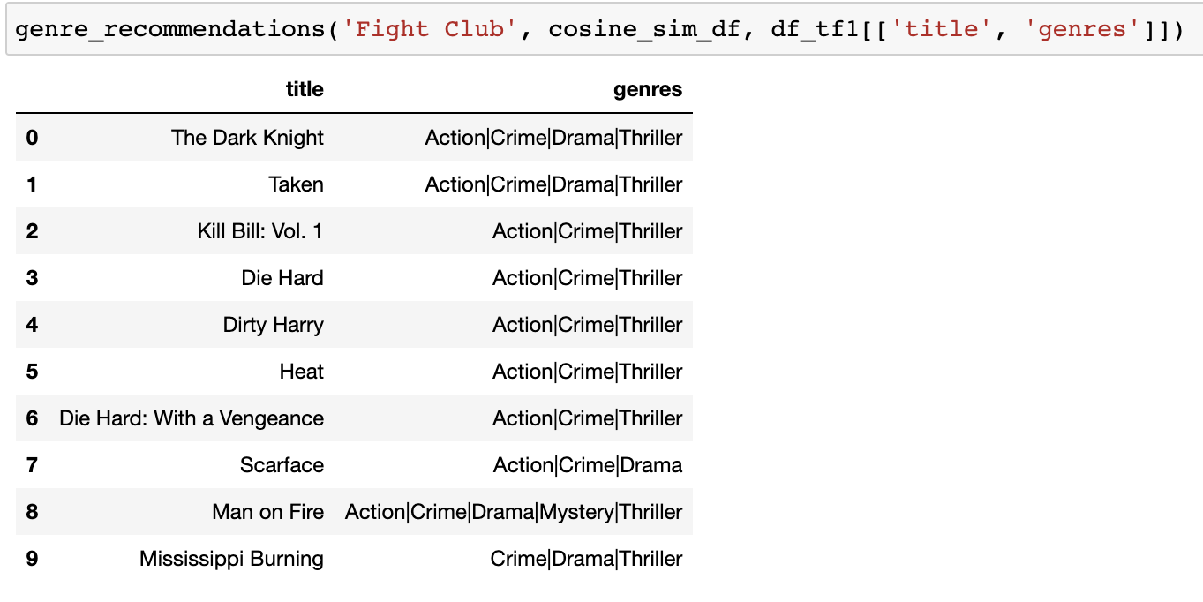
CONTENT BASED – TF IDF RECOMMENDATION

Slide 20
CONTENT BASED – TRANSFORMER (BERT)
Import Data
Data Processing
Embedding using Distilled Roberta
Dimensionality Reduction
Model Training
Giving Recommendations

Slide 21
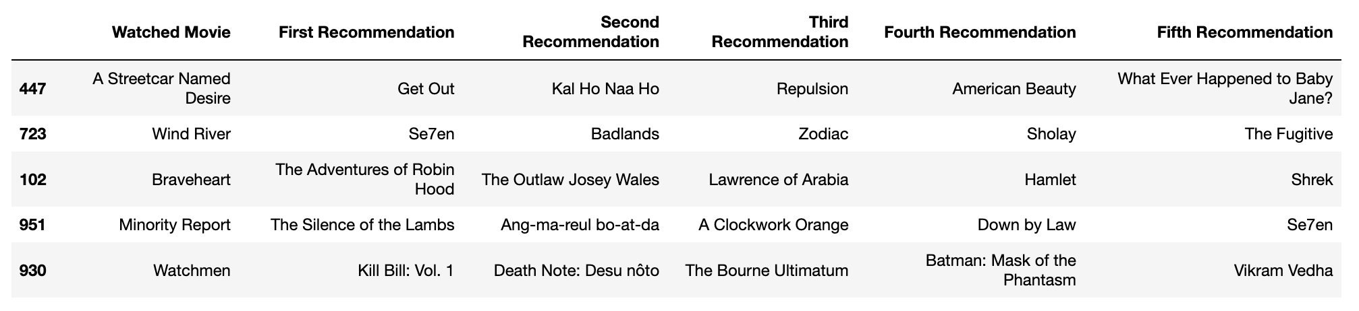
CONTENT BASED – BERT RECOMMENDATIONS

Slide 22
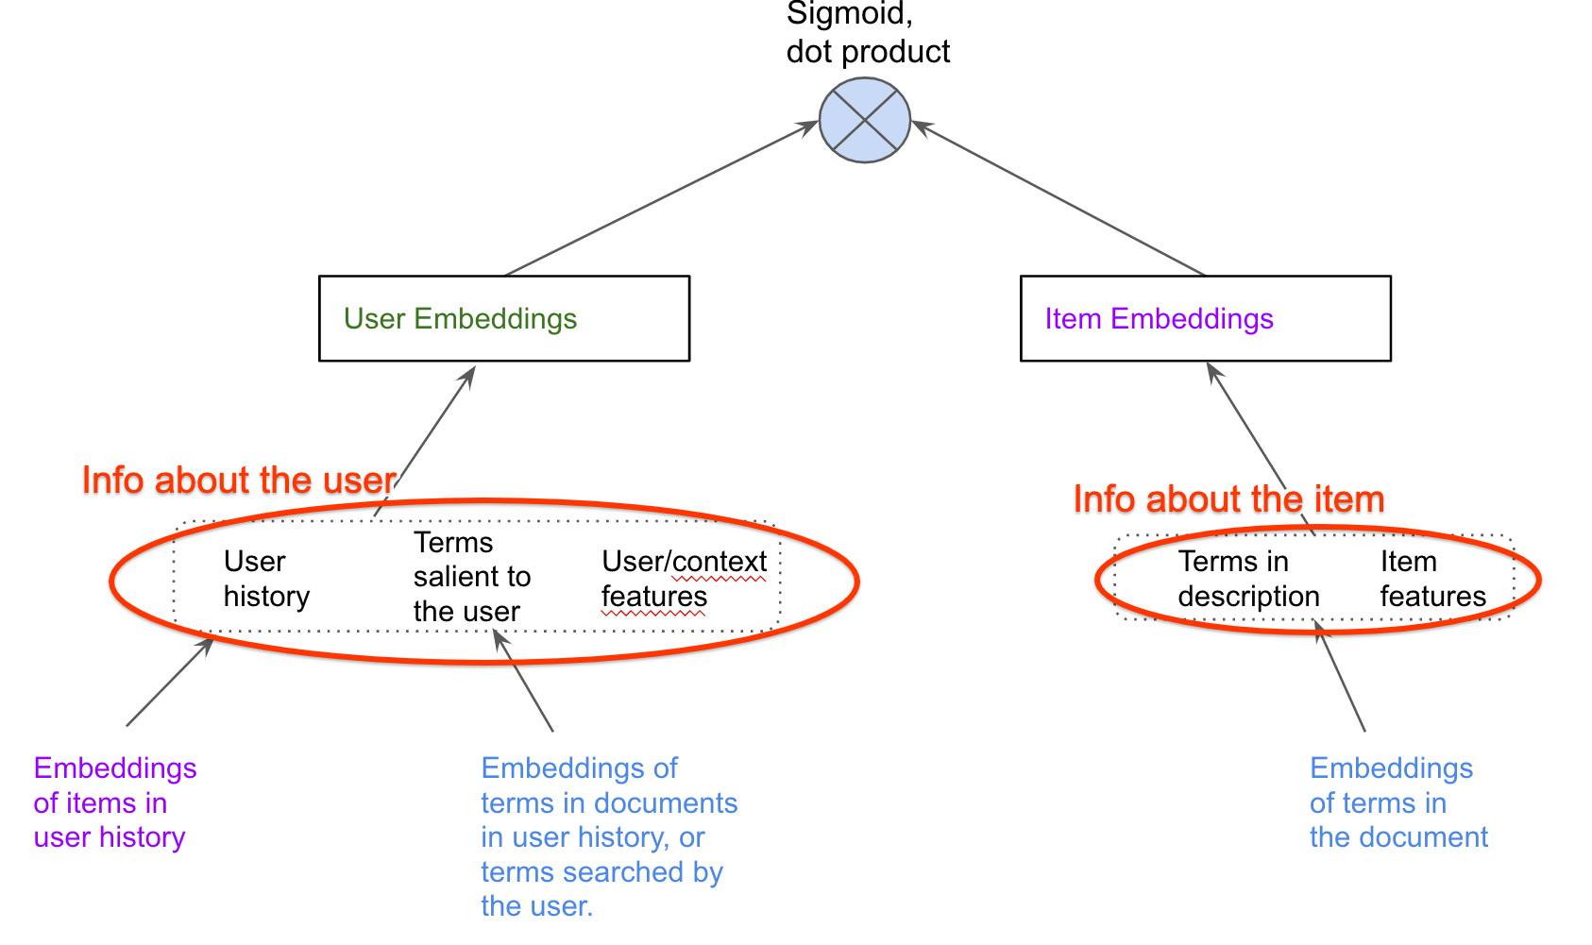
TWO TOWER
The name two towers is derived from the fact that there are 2 towers one for learning the encoding of the users and the other for learning the encodings of the items.
The Two Tower Neural Network is a collaborative filtering approach.
Example: If User A has liked Product A. User B and User A are found to be exhibiting similar patterns, then Product A is recommended to User B.
Notes:
The two-tower model is used to retrieve a small subset of items that are most relevant to the user from the thousands and even millions of items that are available in the system
The two-tower model trains two neural networks: a user encoder and an item encoder. These encoders produce “vector embeddings” which are a list of abstract numerical features that represent all semantic knowledge about the user or the item
The user encoder takes in information about the user, such as their demographic details, and interaction history with items, browsing histories, location, preferred languages, and other metadata.
The item encoder takes in information about the items, such as their description, domain etc..
The product of the user and the item embedding is used to select the top recommended items.

Slide 23
TWO TOWER FLOW
Import Data
Data Preprocessing
Split the data into train and test
Embedding
Candidate Tower
Training and Evaluation
Generate Predictions

Slide 24
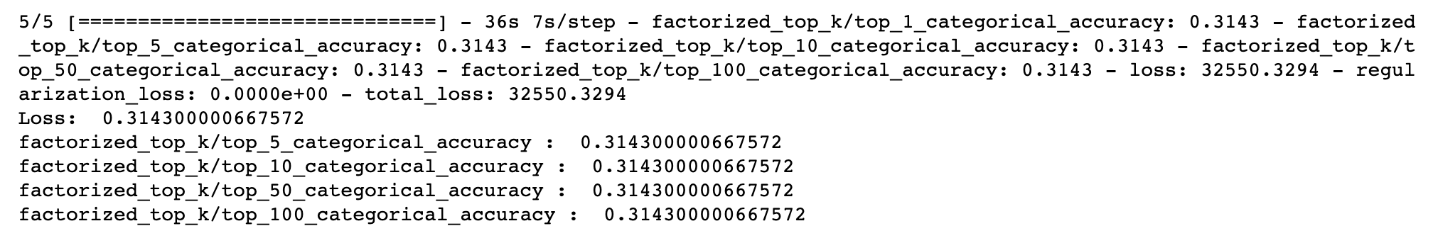
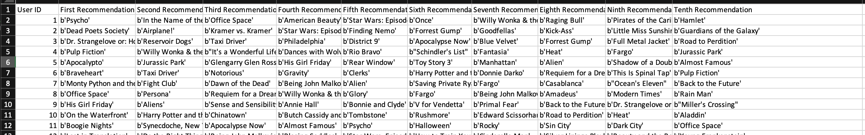
Two Tower Evaluation and Recommendations

Slide 25
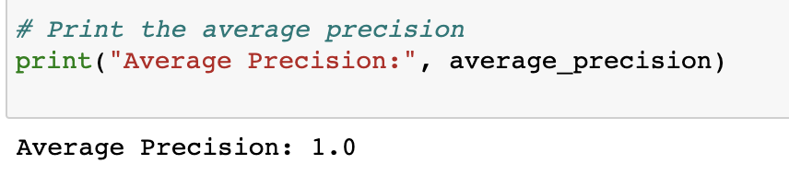
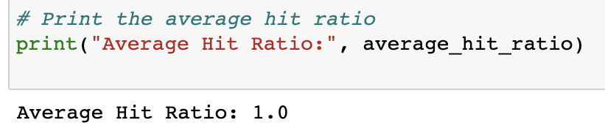
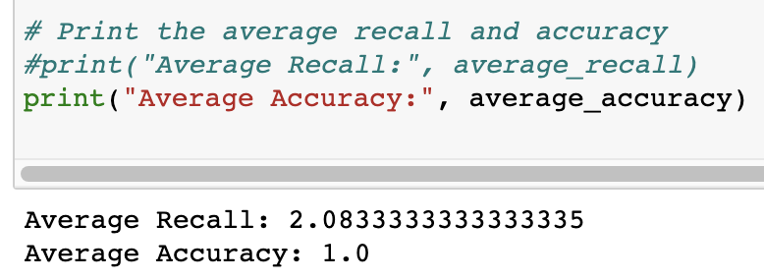
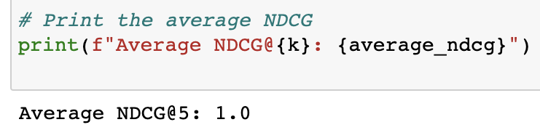
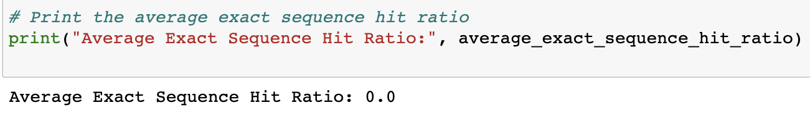
Performance Metrics

Slide 26

DEMO

Slide 27

SUMMARY
Develop an algorithm to give recommendations based of different aspects of the real world and show how it would look like using and UI.
Different algorithms give different results and recommendations because of the models used.
Recommendation engines don’t have very much high accuracy but the way to judge a recommendation is the recommendations itself.

Slide 28
FUTURE WORK
Use different performance metrics to measure the accuracy of the different algorithms used.
Apart form the tradition performance metrics also use the real-life performance metrics to see how the recommendation engine is working.

Slide 29

THANK YOU

